Slide 1
The Historic 2020 Fire Year: A Landscape Assessment to Inform Post-fire Forest Management
Kyle Rodman, Kimberley Davis, Marin Chambers, Teresa Chapman, Paula Fornwalt, Sarah Hart, Laura MarshalL, Charles Rhoades, Catherine Schloegel, Camille Stevens-Rumann, and Thomas Veblen

Slide 2
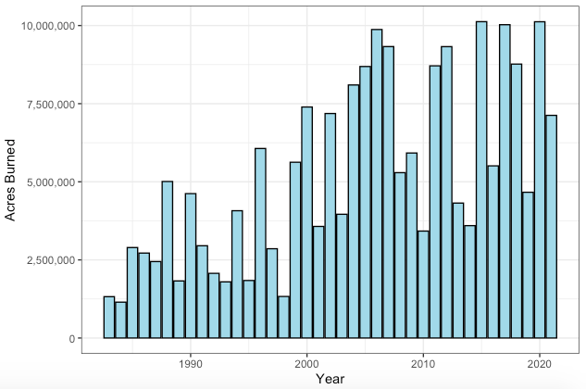
Motivation
Data from NIFC.gov
Over 10 million acres burned across US in 2020
Several of the largest fires on record in northern CO/southern WY

Slide 3
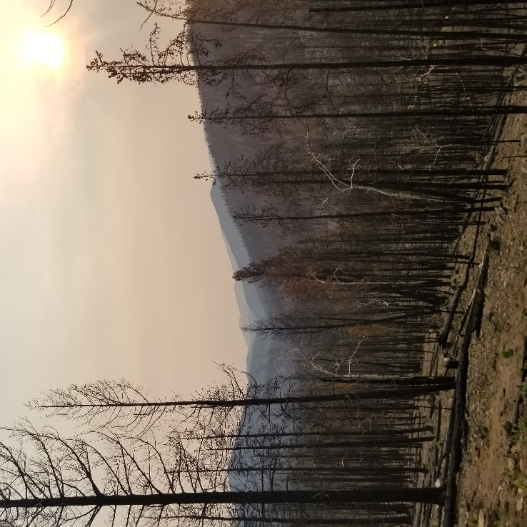
Motivation
Uncertainty about what happens next? Recovery will likely be variable
Photo Credit: Kate Weimer, CFRI/CSU

Slide 4
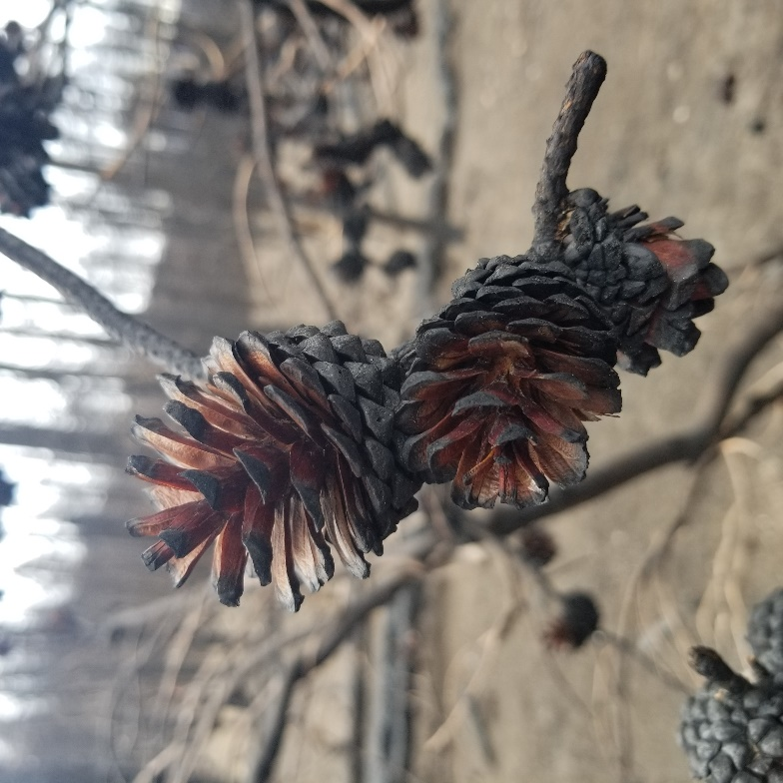
Motivation
Notably, less recent experience with subalpine fires in this region relative to other forest types
Vast majority of area burned in 2020 wildfires in this region was in subalpine
Photo Credit: Kate Weimer, CFRI/CSU

Slide 5
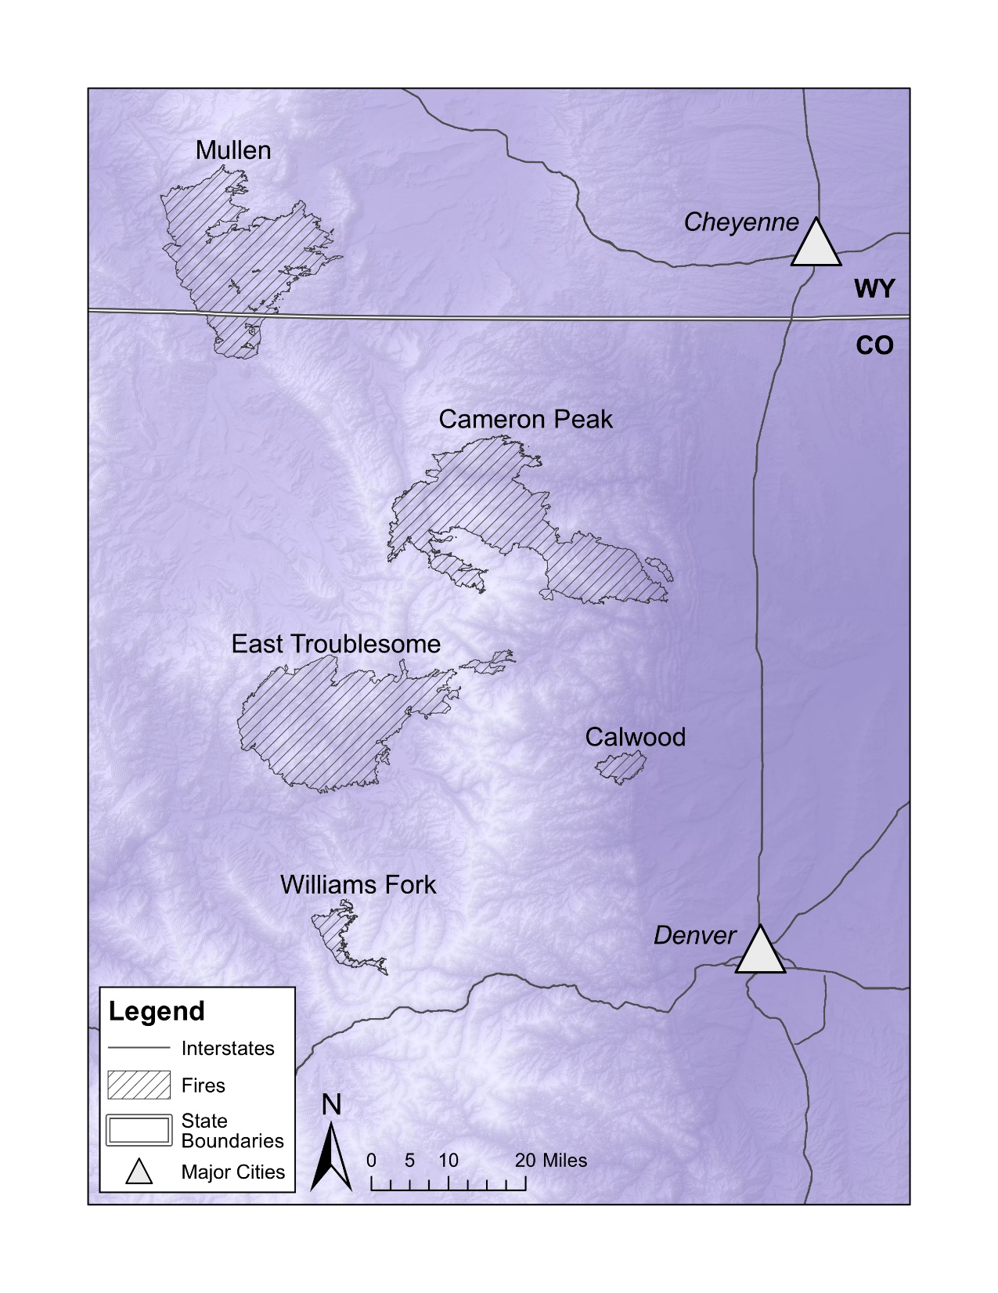
Overall Goal
Facilitate cross-boundary planning across landscapes of five 2020 fires
Using broad-scale spatial data and > 10,000 field plots across recent fires in western US

Slide 6
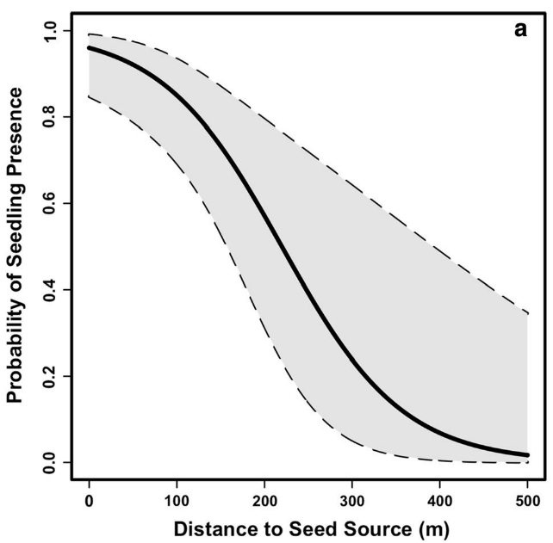
Goal 1 – Distance to Live Trees?
For many conifers in this region (except lodgepole pine), post-fire recovery is limited by seed dispersal from live trees
Patterns of live trees may be more ecologically meaningful than % high-severity fire alone
Distances to live trees from newly developed fire severity maps and pre-fire canopy height
Figure from Kemp et al. 2016

Slide 7
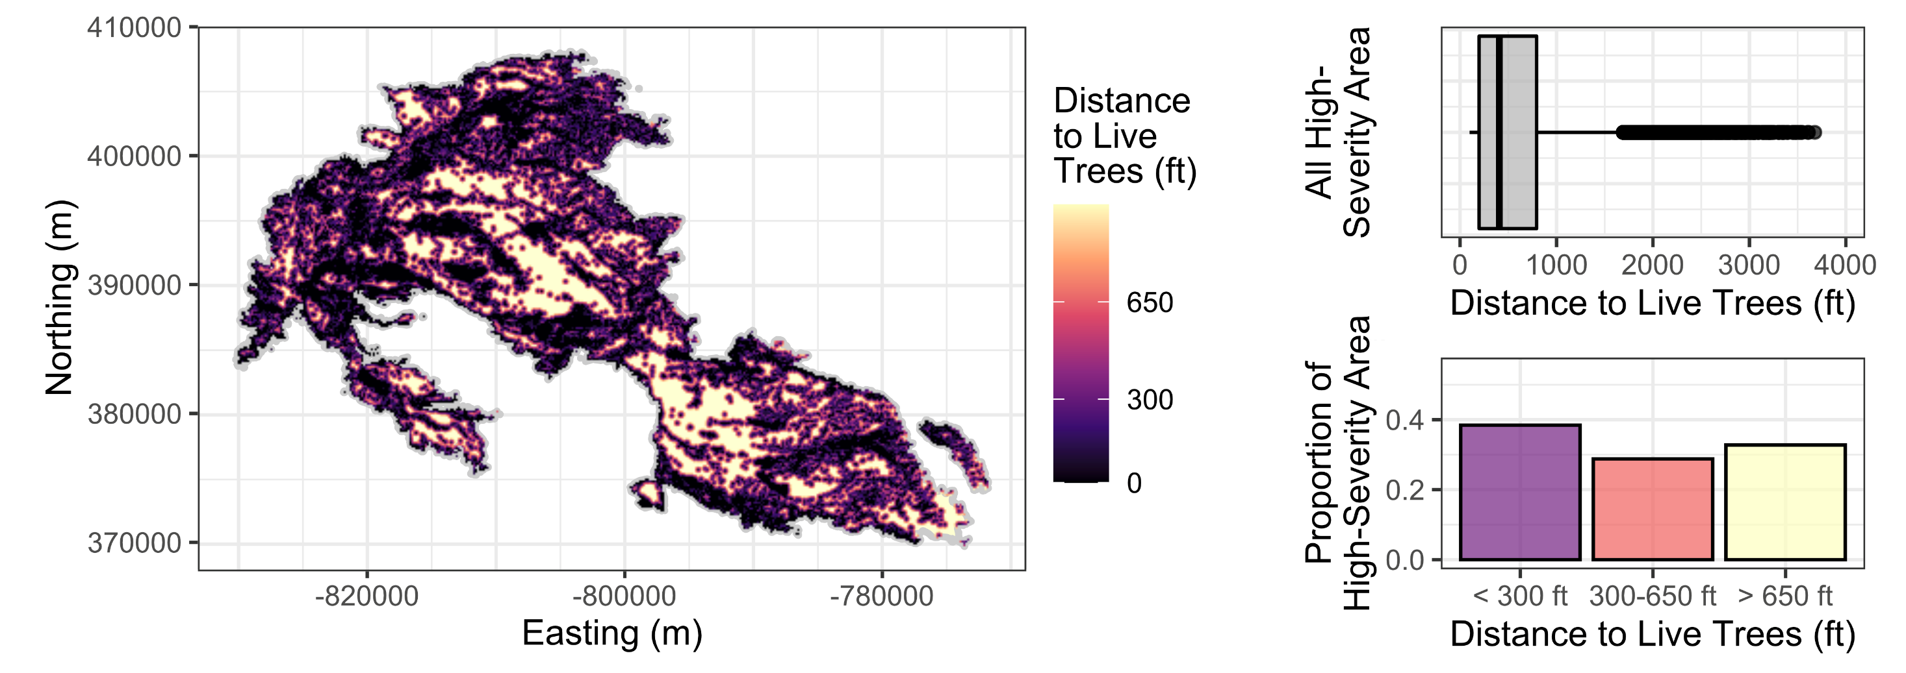
Goal 1 – Distance to Live Trees?
Example from 2020 Cameron Peak Fire

Slide 8
Goal 1 – Distance to Live Trees?
42.8 – 58.5% high severity in these five fires
But, of this high-severity area, only 27.8% is far (> 650 ft) from live trees and will have very limited seed dispersal from survivors
Lodgepole pine (92.5%) and aspen (54.0%) were present in many of these areas too and could facilitate recovery

Slide 9
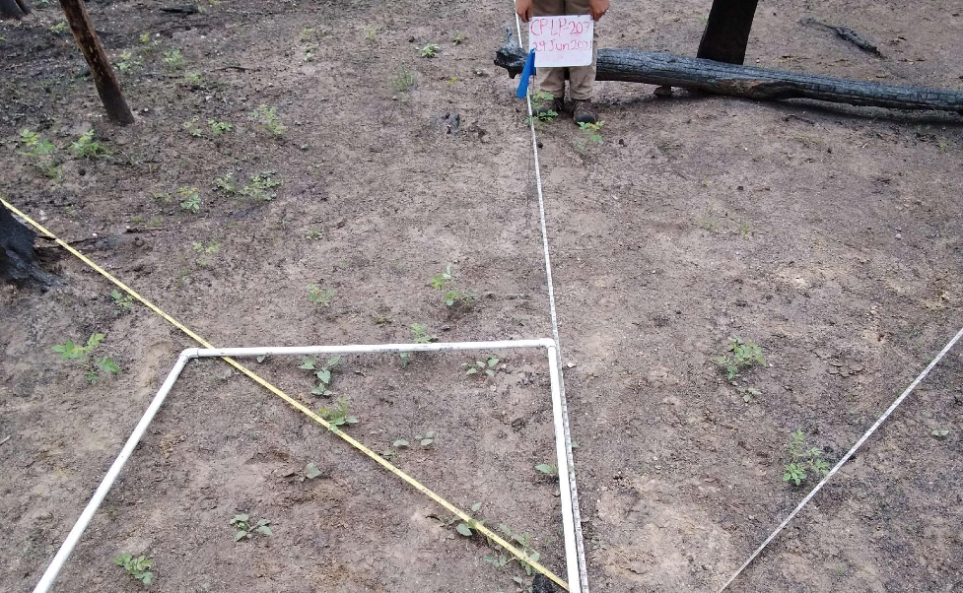
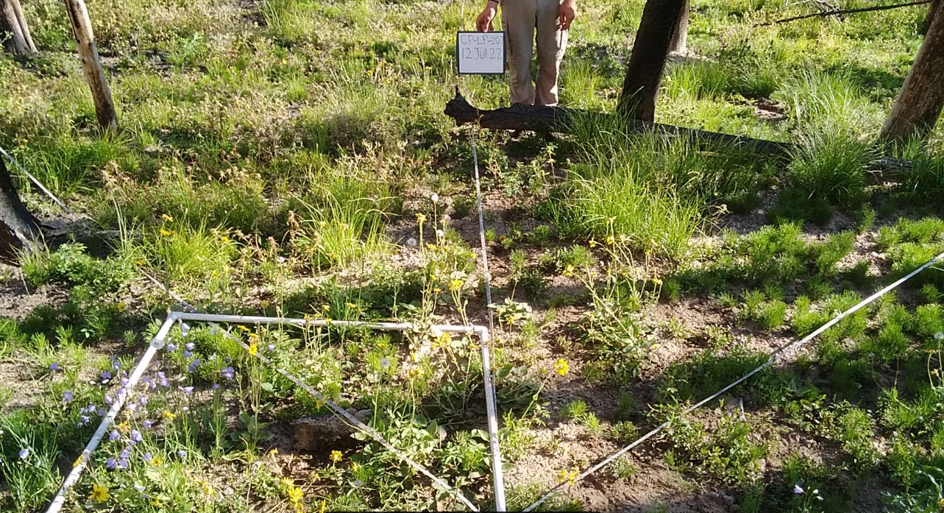
Goal 2 – Natural Recovery?
Predict conifer forest recovery potential across each fire
Dominant conifers including
Engelmann spruce
Douglas-fir
Lodgepole pine
Ponderosa pine
Subalpine fir
Photo Credit: CFRI field crews, 2021-2022
Notes:
Note: Helps us to determine if predicted post-fire trajectories align with desired conditions. Is there a need for intervention?

Slide 10
Goal 2 – Natural Recovery?
Predict conifer forest recovery potential across each fire
Dominant conifers including
Engelmann spruce
Douglas-fir
Lodgepole pine
Ponderosa pine
Subalpine fir
Photo Credit: CFRI field crews, 2021-2022

Slide 11
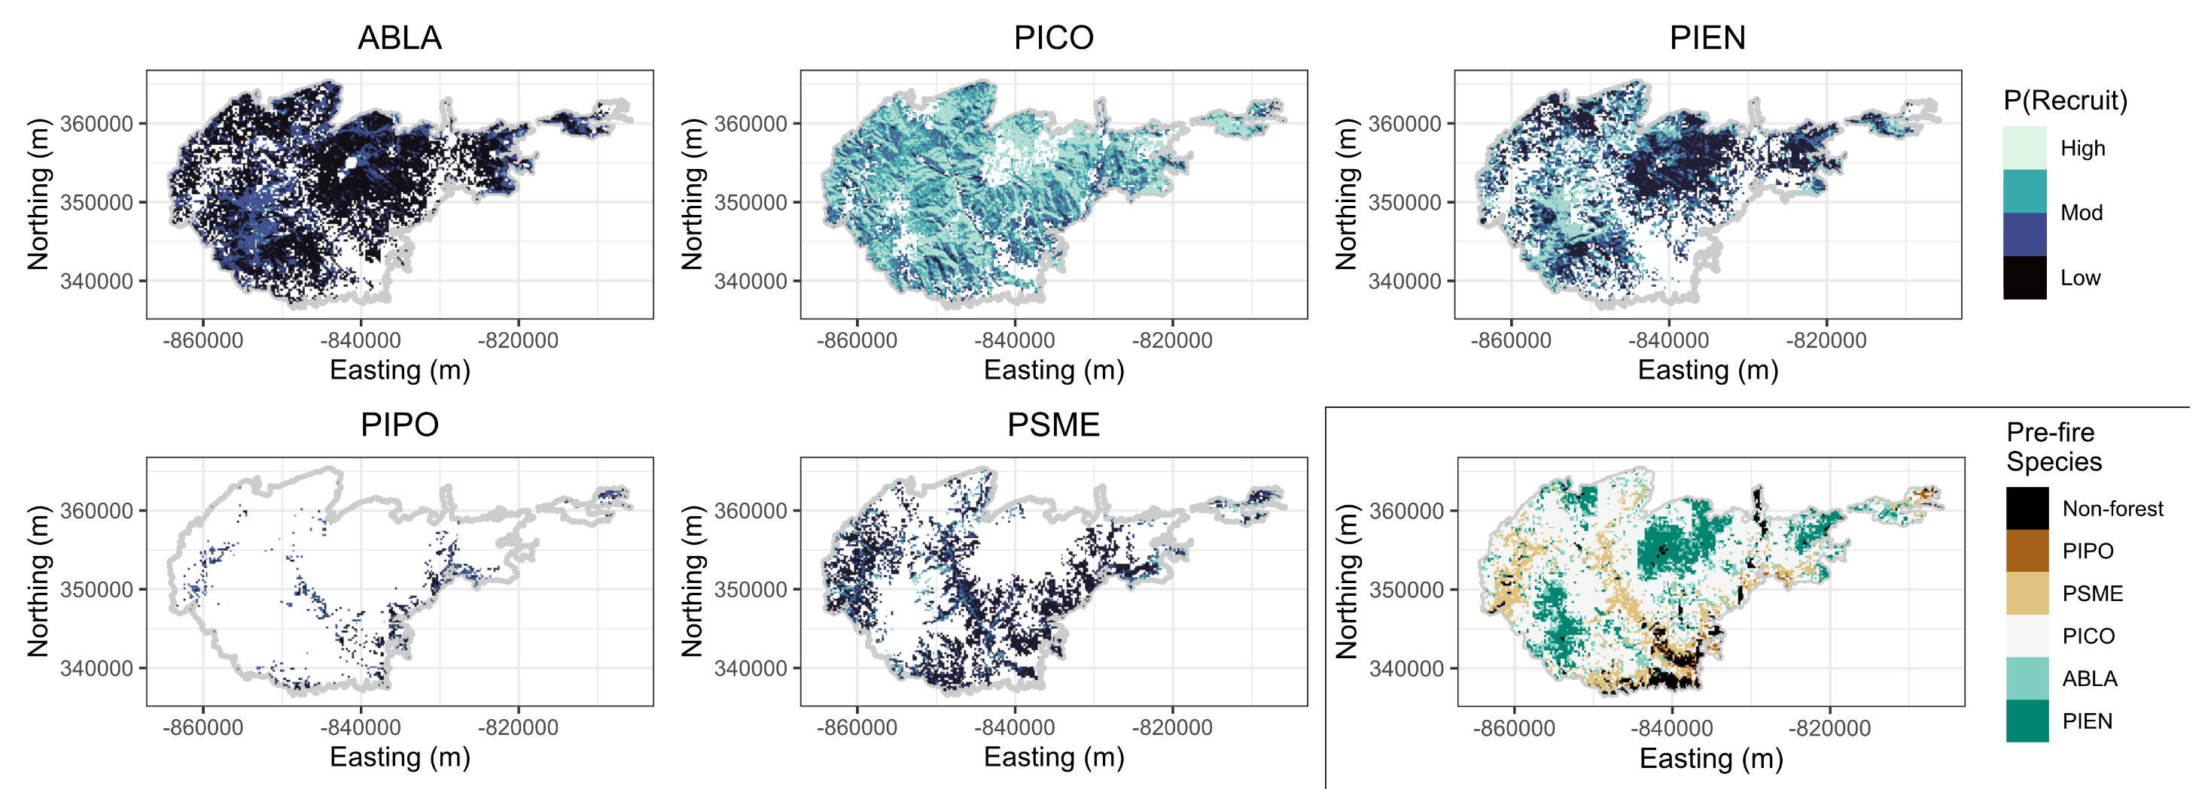
Goal 2 – Natural Recovery?
Example from 2020 East Troublesome fire – ABLA (subalpine fir), PICO (lodgepole pine), PIEN (Engelmann spruce), PIPO (ponderosa pine), PSME (Douglas-fir)
Notes:
Note - > 40 trees/acre of a given species establishing with 10 years of fire. Limited to areas with species present pre-fire

Slide 12
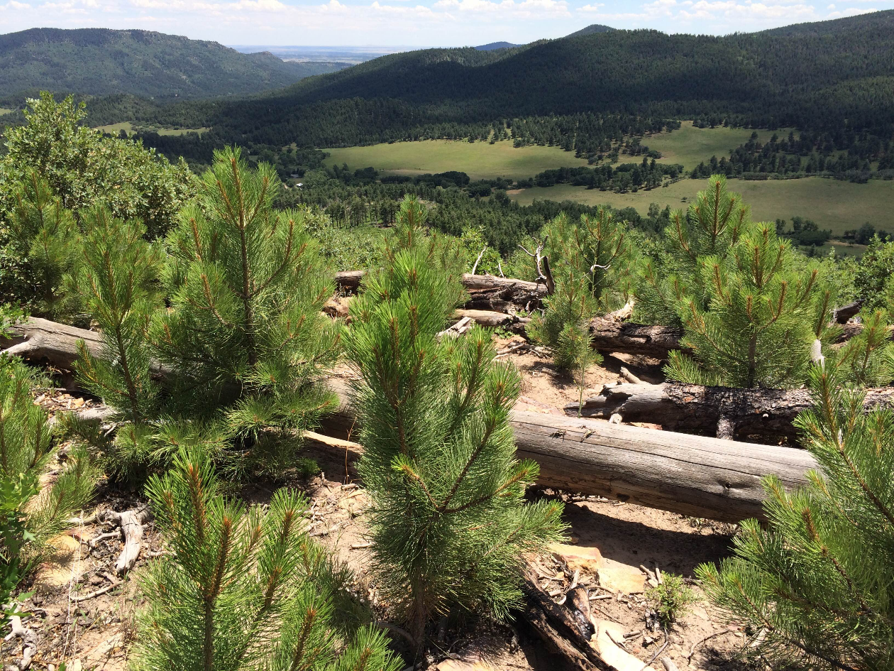
Goal 2 – Natural Recovery?
Natural recovery potential varies widely among fires and tree species
Lodgepole pine has moderate to high recruitment probability across 60% of the total burned area
Engelmann spruce ca. 20%
Other species were more localized but still important (e.g., ponderosa pine at high elevations in Calwood fire)
Photo Credit: Kyle Rodman, ERI

Slide 13
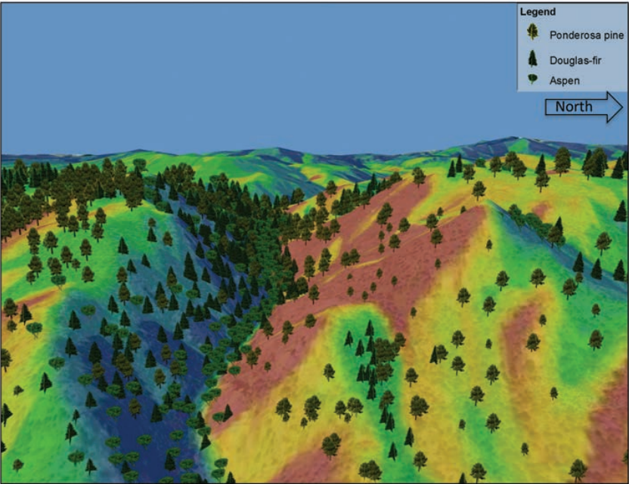
Goal 3 – Suitable Climate for Planting?
Trees can live for a long time
They are representative of the conditions in which they established, not necessarily current or future climate
Where are recent climatic and topographic conditions most suitable for each species??
Figures from Addington et al. (2018)
Notes:
Note: Where might the planting of each species lead to the greatest survival?

Slide 14
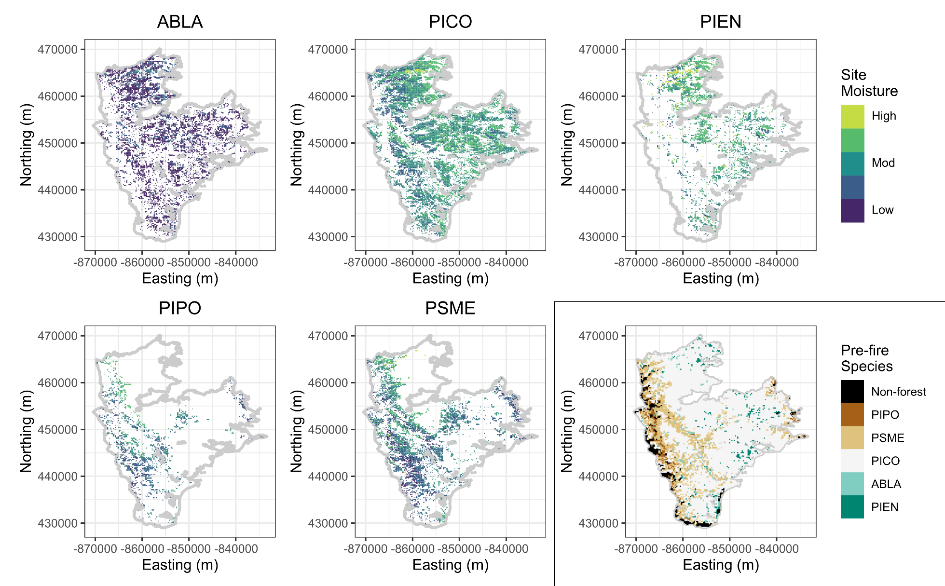
Goal 3 – Suitable Climate for Planting?
Example from 2020 Mullen fire – ABLA (subalpine fir), PICO (lodgepole pine), PIEN (Engelmann spruce), PIPO (ponderosa pine), PSME (Douglas-fir)

Slide 15
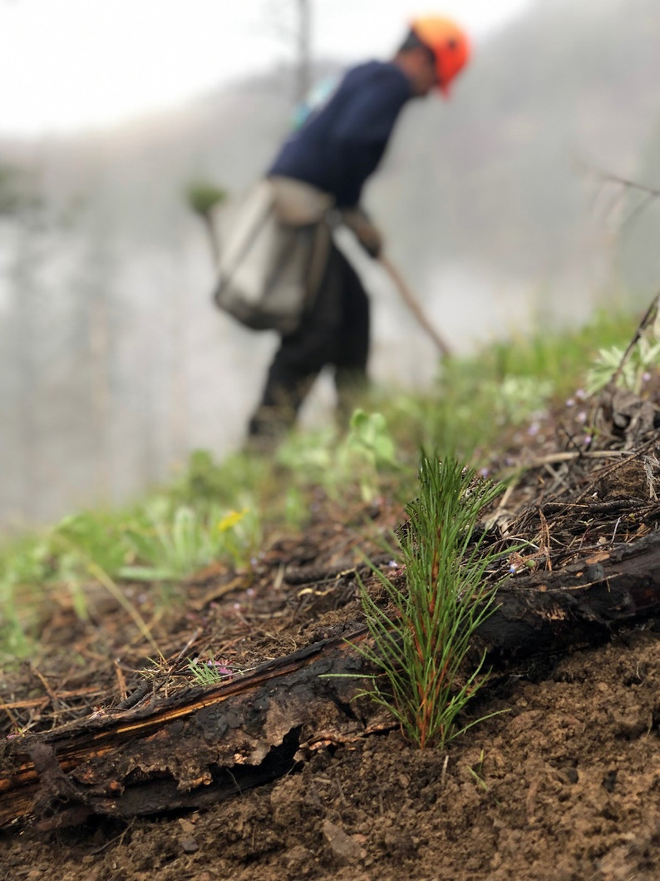
Goal 3 – Site Moisture for Planting?
Again, high variability among fires and tree species
Large areas of moderate to high site suitability for lodgepole pine (44% of the high-severity area) and Engelmann spruce (35%)
Other species still locally important (Douglas-fir 17% and ponderosa pine 9%)
Photo Credit: Catilin Bailey, USDA Forest Service

Slide 16
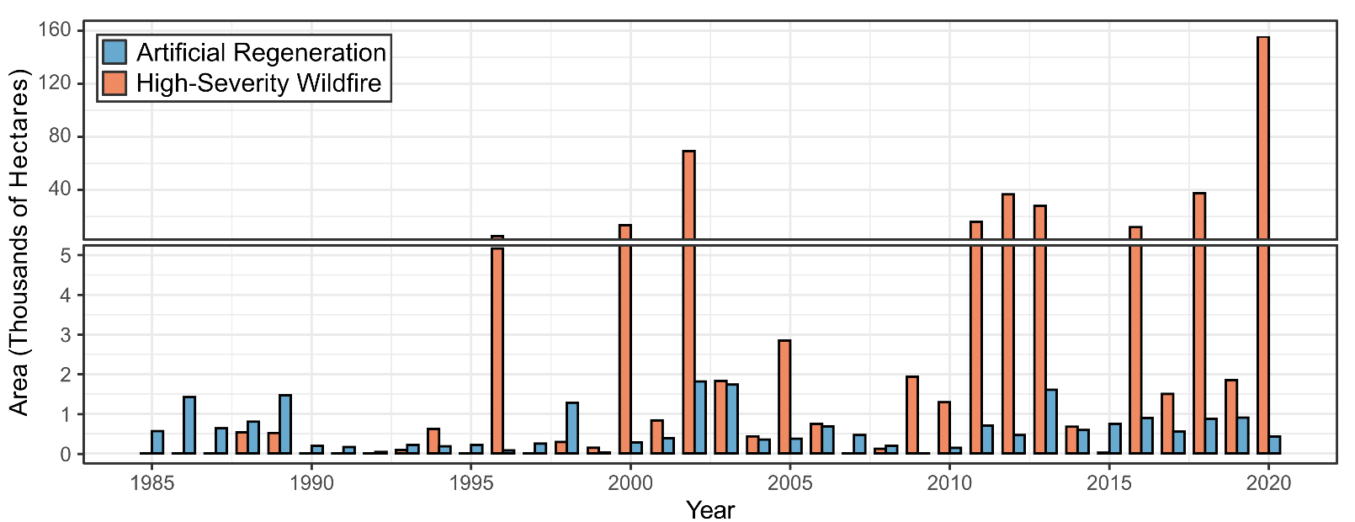
Summary
The scale of the 2020 wildfires highlights the need for strategic planning in post-fire landscapes

Slide 17
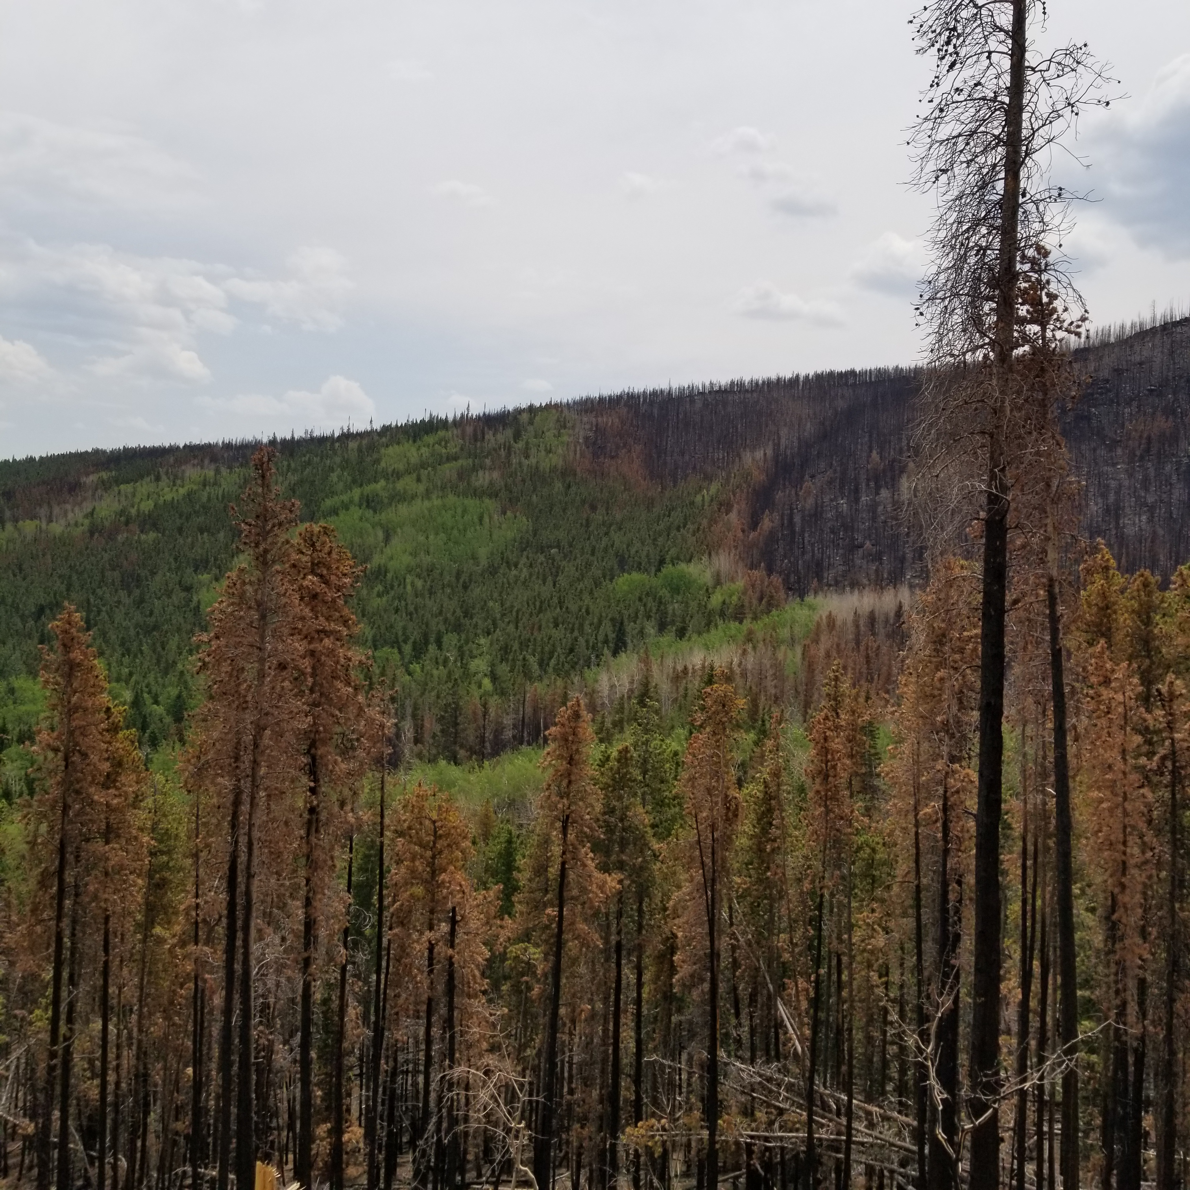
Summary
By identifying areas with greatest likelihood of natural recovery and suitability for existing tree species, new information helps with local decision making
Photo Credit: Kate Weimer, CFRI/CSU

Slide 18
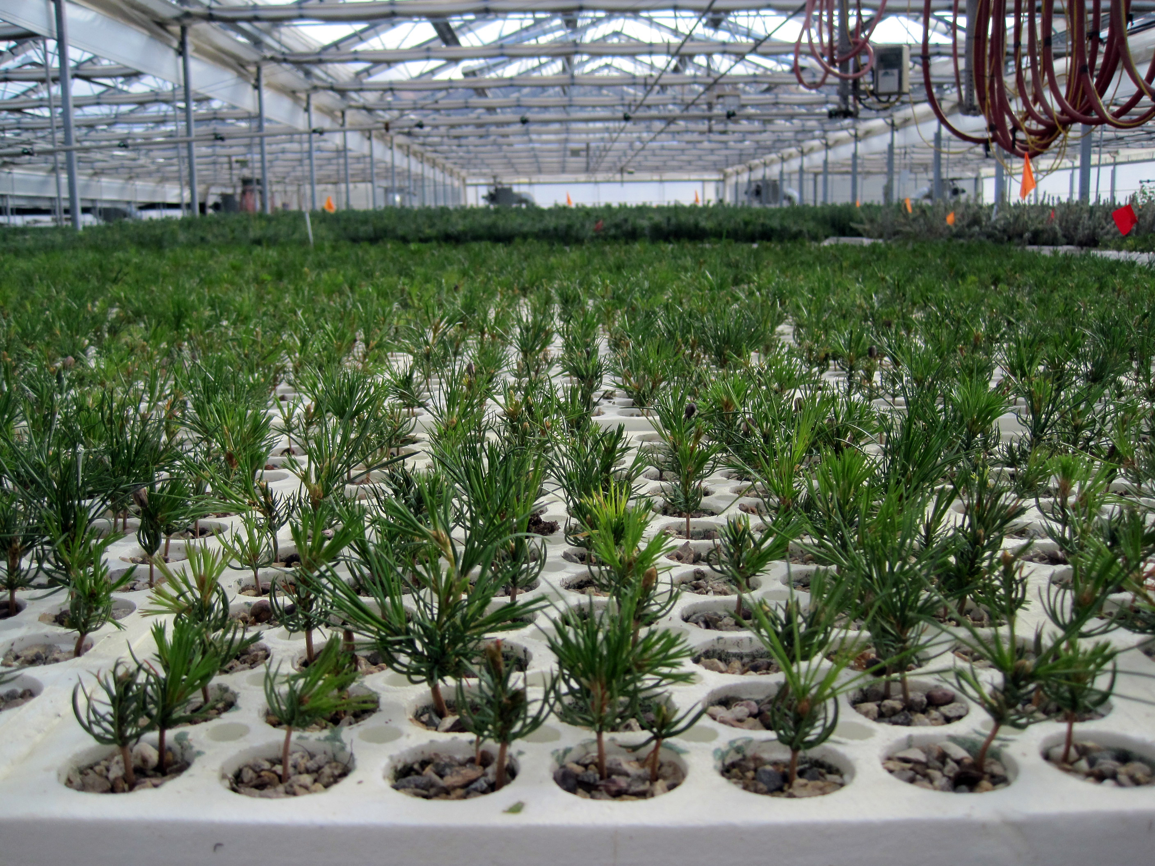
Summary
No substitute for local knowledge and experience of managers and stakeholders!
Photo Credit: Nicole Balloffet, USDA Forest Service
Notes:
Managers play the most important role here. Our hope is to provide additional information that may make it easier to make decisions, particularly at broad scales and across boundaries

Slide 19
Report and Data Availability
Draft Report -- https://cfri.colostate.edu/wp-content/uploads/sites/22/2022/11/NFR_2020Fires_Report.pdf
Spatial Data and Maps -- https://cfri.app.box.com/folder/182650899411?s=oqqbtfetqpcg5tb5flrtmg8862kh4ahu
ESRI Storymap – coming soon
Notes:
Note: Add links to chat…

Slide 20
Acknowledgments
Hannah Brown, Angela Hollingsworth, and Brooke Simmons worked on document production, data archiving, and website design
Mark Kohn developed ESRI storymap

