Slide 1

Early-stage seedling regeneration in four 2020 Colorado wildfires across multiple forest types
Marin Chambers, Kevin Barrett, Camille Stevens-Rumann
December 7, 2022
Notes:
Short & long term understory plant community and natural forest recovery in 4 of the 2020 wildfires

Slide 2
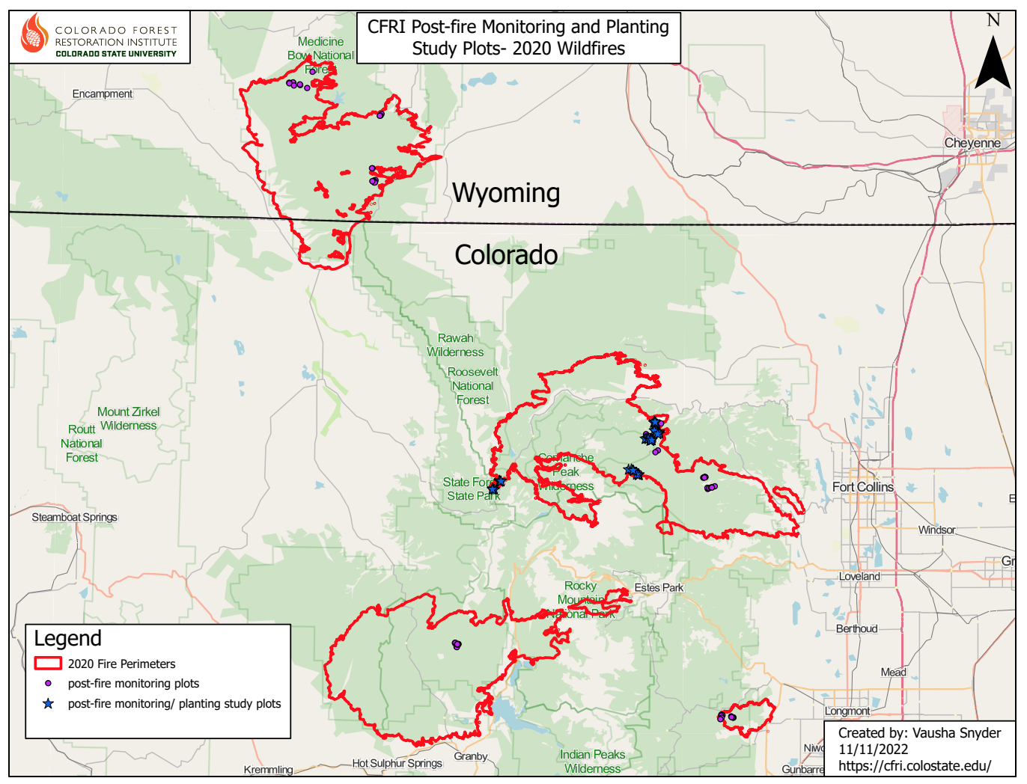
Mullen
Cameron Peak
East Troublesome
Calwood
Notes:
Nealry 120 plots

Slide 3
CFRI YEAR POST-FIRE MONITORING
Four 2020 Colorado Wildfires
  Calwood
  Cameron Peak
  East Troublesome
  Mullen
Severity types:
  High = 100% overstory mortality
  Low/moderate = <90% mortality
  Defined by SBS layers and field assessment
2020 Cameron Peak Fire
Monitoring timeline:
1 yr post-fire – 2021
2 yr post-fire - 2022
2020 Cameron Peak Fire

Slide 4
CFRI 1- & 2- YEAR POST-FIRE MONITORING
CFRI post-fire crew, 2020 Cameron Peak Fire
All forest vegetation types burned were sampled (based on LandFire data)
  Ponderosa pine
  Mixed conifer (dry and mesic lumped)
  Lodgepole
  Spruce/Fir
Sampled
  Tree germination
  Understory recovery
  Fuels dynamics
**Unable to sample mixed conifer sites in Year 2

Slide 5
ABLA = subalpine fir; PICO = lodgepole pine; PIEN = Engelmann spruce; PIPO= ponderosa pine; PIPU = blue spruce;
POTR5 = aspen; PSME = Douglas fir; UNK = unknown
Notes:
X axis – germinants/ac
Y axis – species by forest type
Split up by fire severity and year sampled
2021- HS plots saw no germination, LM plots saw ~400 germinants/ac of PIPO
2022 – LM plots saw just over ~200 germ/ac of PIPO; HS plots saw some germ of PIPO and PSME

Slide 6
ABLA = subalpine fir; PICO = lodgepole pine; PIEN = Engelmann spruce; PIPO= ponderosa pine; PIPU = blue spruce;
POTR5 = aspen; PSME = Douglas fir; UNK = unknown
Notes:
CP Fire – sampled all forest types
2021 – HS – PIPO: very little PIPO regen; MC: very little PICO, PIPO, POTR regen; PICO: 32,000 germ/ac PICO; SF: small amounts of PIPU
- HS – PIPO: very little PIPO regen; MC: weren’t able to sample; PICO: saw a decline in PICO germ, some POTR germ; SF: little ABLA and UNK germ

Slide 7
ABLA = subalpine fir; PICO = lodgepole pine; PIEN = Engelmann spruce; PIPO= ponderosa pine; PIPU = blue spruce;
POTR5 = aspen; PSME = Douglas fir; UNK = unknown
Notes:
2021 – LM - PIPO: very little PIPO regen; MC: very little PICO, PIPO, PSME germ; PICO: ~8000/germ/ac; SF: small amounts of ABLA, PIEN germ
2022 – LM - PIPO: decline in PIPO regen; MC: weren’t able to sample; PICO: slight increase in PICO, some POTR; SF: same rates of germ for ALBA, but PIEN declined.

Slide 8
ABLA = subalpine fir; PICO = lodgepole pine; PIEN = Engelmann spruce; PIPO= ponderosa pine; PIPU = blue spruce;
POTR5 = aspen; PSME = Douglas fir; UNK = unknown
Notes:
Only able to sample SF forest type in ET Fire
High severity plots saw zero regeneration in 2021 and 2022
LM plots – 2021, >1300 germ/ac of ABLA, which declined to 500 germ/ac in 2022. PIEN germination was present in both 2021 and 2022, but declined by over half in 2022 from 2021 values. PIPU germ was present in 2021 but none were recorded in 2022. Small amount of lodgepole in the LM plots.

Slide 9
ABLA = subalpine fir; PICO = lodgepole pine; PIEN = Engelmann spruce; PIPO= ponderosa pine; PIPU = blue spruce;
POTR5 = aspen; PSME = Douglas fir; UNK = unknown
Notes:
Mullen – sampled PICO and SF forest types
HS – PICO: large flush of PICO germ in 2021 which declined in 2022. Also saw an increase in POTR sprouting in 2022.
SF: in 2021 has presence of ABLA and PICO germ, in 2022 saw a slight increase in ABLA germ, slight decrease in PICO germ, tiny amount of PIEN and POTR germ

Slide 10
ABLA = subalpine fir; PICO = lodgepole pine; PIEN = Engelmann spruce; PIPO= ponderosa pine; PIPU = blue spruce;
POTR5 = aspen; PSME = Douglas fir; UNK = unknown
Notes:
LM – PICO: 2021 small amounts of ABLA/PIEN germination with a larger amount of PICO germ, very small amount of PIPU germ.
In 2022, lost some ABLA/PIEN, had a slight increase in PIPU and a huge flush of germ of PICO.
SF: ABLA germ consistent between 2021 and 2022 and in 2022 saw some PIEN germ.

Slide 11
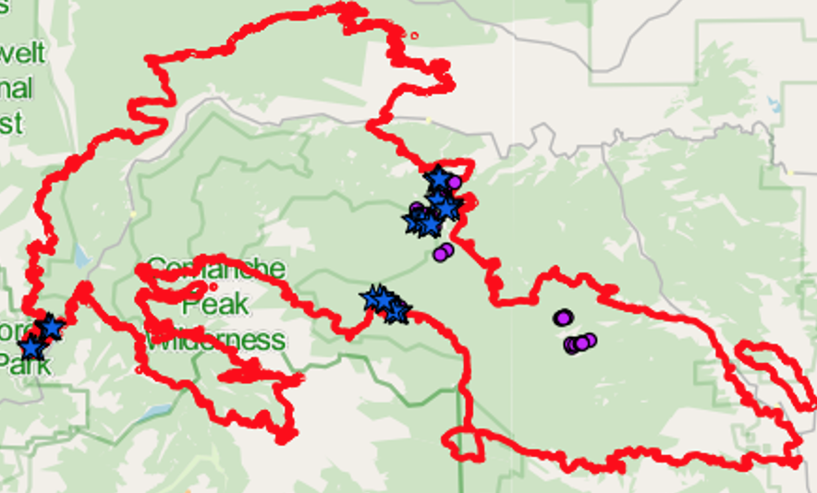
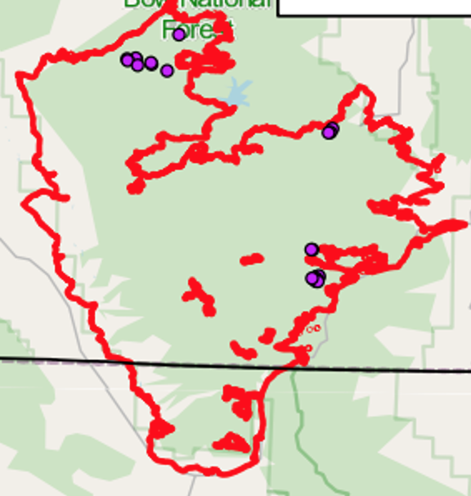
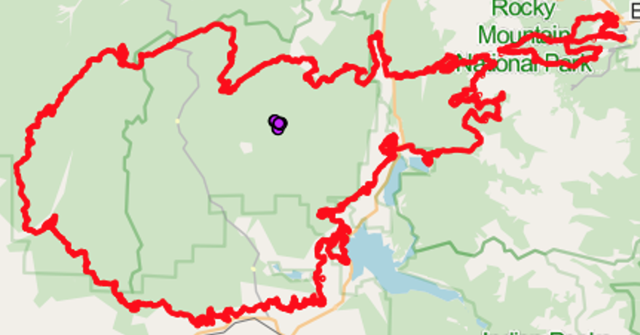
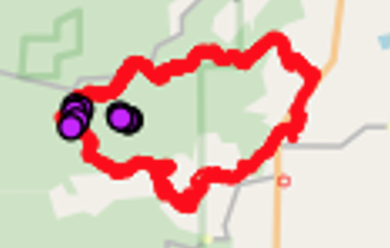
Notes:
HWY 125

Slide 12
Fire | Forest Type | Severity | n 2021 | 2021 plots with no recruits (%) | n 2022 | 2022 plots with no recruits (%)
Calwood | Ponderosa | Low-mod | 6 | 17% | 6 | 50%
Calwood | Ponderosa | High | 6 | 100% | 6 | 50%
Cameron Peak | Ponderosa | Low-mod | 6 | 0% | 8 | 63%
Cameron Peak | Ponderosa | High | 6 | 83% | 11 | 36%
Cameron Peak | Mixed conifer | Low-mod | 6 | 0% | na | na
Cameron Peak | Mixed conifer | High | 6 | 33% | na | na
Cameron Peak | Lodgepole | Low-mod | 6 | 0% | 12 | 0%
Cameron Peak | Lodgepole | High | 10 | 10% | 12 | 0%
Cameron Peak | Spruce-fir | Low-mod | 5 | 40% | 5 | 0%
Cameron Peak | Spruce-fir | High | 5 | 0% | 5 | 0%
East Troublesome | Spruce-fir | Low-mod | 6 | 17% | 5 | 20%
East Troublesome | Spruce-fir | High | 6 | 100% | 6 | 100%
Mullen | Lodgepole | Low-mod | 6 | 17% | 6 | 0%
Mullen | Lodgepole | High | 6 | 0% | 6 | 0%
Mullen | Subalpine | Low-mod | 5 | 20% | 5 | 20%
Mullen | Subalpine | High | 7 | 71% | 7 | 71%

Slide 13
Fire | Forest Type | Severity | n 2021 | 2021 plots with no recruits (%) | n 2022 | 2022 plots with no recruits (%)
Calwood | Ponderosa | Low-mod | 6 | 17% | 6 | 50%
Calwood | Ponderosa | High | 6 | 100% | 6 | 50%
Cameron Peak | Ponderosa | Low-mod | 6 | 0% | 8 | 63%
Cameron Peak | Ponderosa | High | 6 | 83% | 11 | 36%
Cameron Peak | Mixed conifer | Low-mod | 6 | 0% | na | na
Cameron Peak | Mixed conifer | High | 6 | 33% | na | na
Cameron Peak | Lodgepole | Low-mod | 6 | 0% | 12 | 0%
Cameron Peak | Lodgepole | High | 10 | 10% | 12 | 0%
Cameron Peak | Spruce-fir | Low-mod | 5 | 40% | 5 | 0%
Cameron Peak | Spruce-fir | High | 5 | 0% | 5 | 0%
East Troublesome | Spruce-fir | Low-mod | 6 | 17% | 5 | 20%
East Troublesome | Spruce-fir | High | 6 | 100% | 6 | 100%
Mullen | Lodgepole | Low-mod | 6 | 17% | 6 | 0%
Mullen | Lodgepole | High | 6 | 0% | 6 | 0%
Mullen | Subalpine | Low-mod | 5 | 20% | 5 | 20%
Mullen | Subalpine | High | 7 | 71% | 7 | 71%
Notes:
LM PIPO plots – generally saw a decline in presence of germination in some plots between 2021 and 2022.
Calwood – 17% of plots saw no germ, which increased to 50% in 2022
Cameron Peak – all of plots in 2021 had some germ, in 2022 63% of plots had no germ with the addition of some new plots.

Slide 14
Fire | Forest Type | Severity | n 2021 | 2021 plots with no recruits (%) | n 2022 | 2022 plots with no recruits (%)
Calwood | Ponderosa | Low-mod | 6 | 17% | 6 | 50%
Calwood | Ponderosa | High | 6 | 100% | 6 | 50%
Cameron Peak | Ponderosa | Low-mod | 6 | 0% | 8 | 63%
Cameron Peak | Ponderosa | High | 6 | 83% | 11 | 36%
Cameron Peak | Mixed conifer | Low-mod | 6 | 0% | na | na
Cameron Peak | Mixed conifer | High | 6 | 33% | na | na
Cameron Peak | Lodgepole | Low-mod | 6 | 0% | 12 | 0%
Cameron Peak | Lodgepole | High | 10 | 10% | 12 | 0%
Cameron Peak | Spruce-fir | Low-mod | 5 | 40% | 5 | 0%
Cameron Peak | Spruce-fir | High | 5 | 0% | 5 | 0%
East Troublesome | Spruce-fir | Low-mod | 6 | 17% | 5 | 20%
East Troublesome | Spruce-fir | High | 6 | 100% | 6 | 100%
Mullen | Lodgepole | Low-mod | 6 | 17% | 6 | 0%
Mullen | Lodgepole | High | 6 | 0% | 6 | 0%
Mullen | Subalpine | Low-mod | 5 | 20% | 5 | 20%
Mullen | Subalpine | High | 7 | 71% | 7 | 71%
Notes:
LM – PICO – as expected, all plots had some germination by 2022
CP – saw germination in all plots in 2021 and 2022
Mullen – some plots with no germ in 2021 but in 2022 all plots had some germination

Slide 15
Fire | Forest Type | Severity | n 2021 | 2021 plots with no recruits (%) | n 2022 | 2022 plots with no recruits (%)
Calwood | Ponderosa | Low-mod | 6 | 17% | 6 | 50%
Calwood | Ponderosa | High | 6 | 100% | 6 | 50%
Cameron Peak | Ponderosa | Low-mod | 6 | 0% | 8 | 63%
Cameron Peak | Ponderosa | High | 6 | 83% | 11 | 36%
Cameron Peak | Mixed conifer | Low-mod | 6 | 0% | na | na
Cameron Peak | Mixed conifer | High | 6 | 33% | na | na
Cameron Peak | Lodgepole | Low-mod | 6 | 0% | 12 | 0%
Cameron Peak | Lodgepole | High | 10 | 10% | 12 | 0%
Cameron Peak | Spruce-fir | Low-mod | 5 | 40% | 5 | 0%
Cameron Peak | Spruce-fir | High | 5 | 0% | 5 | 0%
East Troublesome | Spruce-fir | Low-mod | 6 | 17% | 5 | 20%
East Troublesome | Spruce-fir | High | 6 | 100% | 6 | 100%
Mullen | Lodgepole | Low-mod | 6 | 17% | 6 | 0%
Mullen | Lodgepole | High | 6 | 0% | 6 | 0%
Mullen | Subalpine | Low-mod | 5 | 20% | 5 | 20%
Mullen | Subalpine | High | 7 | 71% | 7 | 71%
Notes:
LM SF – germination is occurring at some level
CP: 2021 40% of plots had no germ, in 2022 all plots had some germ
Mullen – 20% of plots had no germ in either 2021 or 2022

Slide 16
Fire | Forest Type | Severity | n 2021 | 2021 plots with no recruits (%) | n 2022 | 2022 plots with no recruits (%)
Calwood | Ponderosa | Low-mod | 6 | 17% | 6 | 50%
Calwood | Ponderosa | High | 6 | 100% | 6 | 50%
Cameron Peak | Ponderosa | Low-mod | 6 | 0% | 8 | 63%
Cameron Peak | Ponderosa | High | 6 | 83% | 11 | 36%
Cameron Peak | Mixed conifer | Low-mod | 6 | 0% | na | na
Cameron Peak | Mixed conifer | High | 6 | 33% | na | na
Cameron Peak | Lodgepole | Low-mod | 6 | 0% | 12 | 0%
Cameron Peak | Lodgepole | High | 10 | 10% | 12 | 0%
Cameron Peak | Spruce-fir | Low-mod | 5 | 40% | 5 | 0%
Cameron Peak | Spruce-fir | High | 5 | 0% | 5 | 0%
East Troublesome | Spruce-fir | Low-mod | 6 | 17% | 5 | 20%
East Troublesome | Spruce-fir | High | 6 | 100% | 6 | 100%
Mullen | Lodgepole | Low-mod | 6 | 17% | 6 | 0%
Mullen | Lodgepole | High | 6 | 0% | 6 | 0%
Mullen | Subalpine | Low-mod | 5 | 20% | 5 | 20%
Mullen | Subalpine | High | 7 | 71% | 7 | 71%
Notes:
some high severity burn plots saw less conifer germation, particularly in ponderosa and subalpine forest types
Calwood – PIPO – 2021 100% of plots had no germ, but in 2022 we found some germination in half of our plots;
Likewise, CP Fire – PIPO – in 2021 83% of plots had not germination. In 2021 we added an additional 5 plots to our existing plots and only 1/3 of plots had no germination. So 2022 saw some additional germination.
ET SF – as mentioned, we saw no germ in these plots in either 2021 or 2022 – may be a candidate area for planting, further monitoring in these areas critical
Mullen SF – consistently saw that over 2/3 of our plots had no germination in either year. We know that subalpine forests take a long time to recover, so this could just be indicative of differences in forest type post-fire recovery. may be a candidate area for planting, further monitoring in these areas critical

Slide 17
CFRI POST-FIRE MONITORING
Next steps:
Full dataset analysis and reporting
Include other variables such as aspect, elevation, slope, topography, moisture stress, understory vegetation, fine and coarse fuel, etc.
Share more detailed results with ARP and Med-Bow NF staff
Continue to monitor these plots 3?, 5-, 10-, 20+ years post-fire
Add additional plots into the ET Fire?
CFRI post-fire crew, 2020 East Troublesome Fire

Slide 18
THANK YOU!
marin.chambers@colostate.edu
Acknowledgements:
RMRS: Chuck Rhoades
CFRI: Kat Morici, Savannah Lehnert, Sienna Wessel, Allie Rhea
CSU Field crew:
Kate Weimer, Helen Flynn, Tyler Carlson, Stavros Tekosis, Sean McLennan, Michael McNorvell and many more!
ARP staff:
Kevin Zimlinghaus, Kevin McLaughlin, Jonathan Grand, Katie Fialko, Eric Freels, Matt Jurak, Mike Montgomery
CSFS nursery: Orion Aon, David Meeneghan

Slide 19
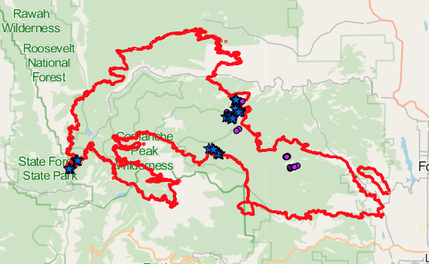
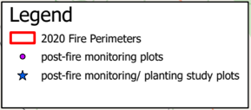
CFRI POST-FIRE PLANTING STUDY
Notes:
Implemented by Camille and I; Planting sites equally cover ponderosa, mixed conifer, lodgepole and spruce fir vegetation types

Slide 20
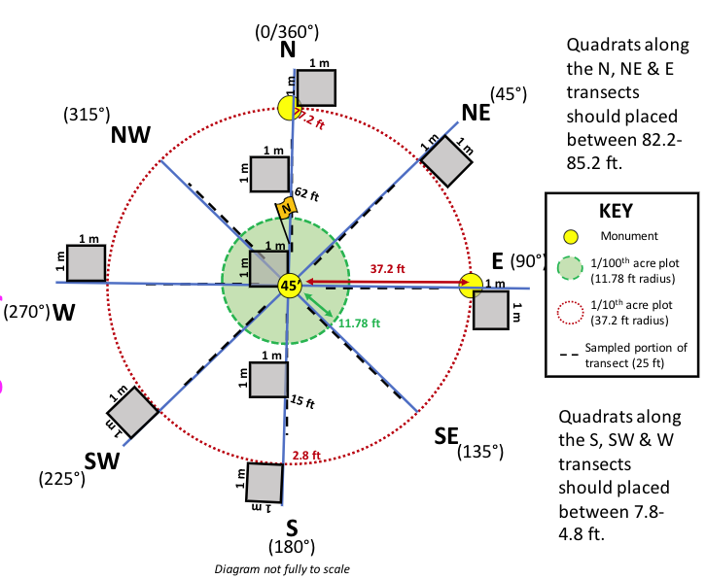
CFRI POST-FIRE PLANTING STUDY
Utilized subset of existing CFRI post-fire monitoring plots
low-moderate and high severity burn areas in 2020 Cameron Peak Fire
Planted Spring 2022:
Ponderosa pine; 8,000’
Ponderosa pine; 9,000’
Douglas-fir
Lodgepole pine
Limber pine
Engelmann spruce
CFRI ”Mothership” plot depiction with planting study modifications
CFRI post-fire planting configuration,
2020 Cameron Peak Fire

Slide 21
CFRI POST-FIRE PLANTING STUDY
Purpose: understand cold and drought tolerances of multiple native conifer species
  post-fire environments
  multiple environmental gradients
Spring/Summer 2022 – set up study
Fall 2022 – monitored survival and growth
CFRI post-fire planting configuration,
2020 Cameron Peak Fire

Slide 22
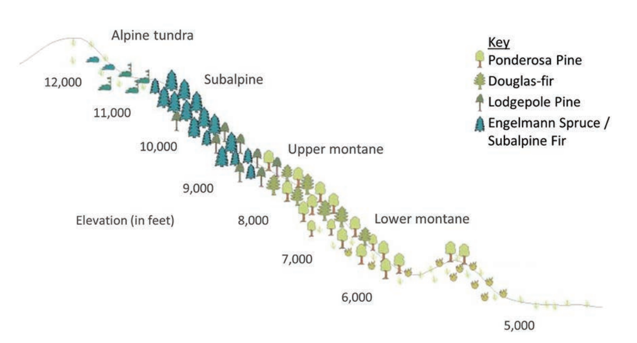
CFRI POST-FIRE PLANTING STUDY
Addington et al. 2018 GTR-373

Slide 23
CFRI POST-FIRE PLANTING STUDY
Next steps:
Preliminary survival and growth results shared with ARP reforestation staff and other partners - early 2023
Spring 2023 and Fall 2023 monitoring
Potentially expanding study to additional fires in 2024
CFRI post-fire planting configuration,
2020 Cameron Peak Fire

